Slide 1
Recommendations for the Distribution of Charging Stations in 2035
Group member: Fangjun Kong, Yicheng Wei, Qinhan Zhou, Guanhua Fu
CIVENG C263H Professor Marta Gonzalez

Slide 2
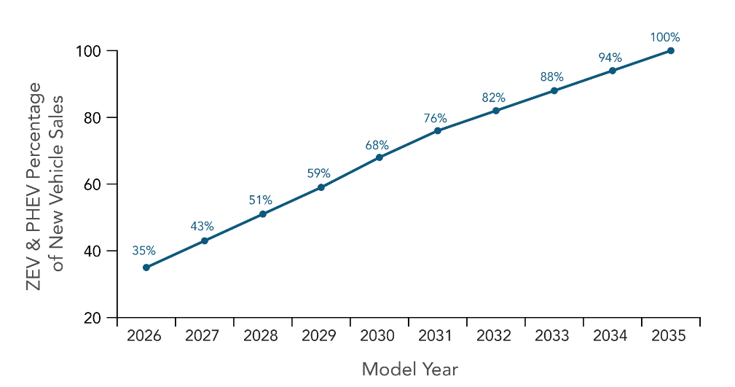
Policy Background
The Advanced Clean Cars II regulation approved by the California Air Resources Board (CARB). This regulation charts a course for California to achieve 100% zero-emission vehicle (ZEV) sales for new cars and light trucks by 2035. This policy not only addresses the urgent need to curb global warming emissions and air pollution but also fosters a robust market for clean, efficient vehicles.
Figure 1: Policy requirements for new energy vehicles over time
Notes:
As the advanced clean cars regulation got approved by the CARB, they aim to achieve 100% zero emission vehicle sales for new cars and light trucks by 2035.
This policy indicates the urgent need to fight for climate change, GHG Emissions, and air pollutions.
More importantly, it also fosters a market for clean, efficient, electric vehicles.
According to the figure on the right, the policy anticipates a trend approaching 100% 0 emission by 2035.
https://ww2.arb.ca.gov/news/california-moves-accelerate-100-new-zero-emission-vehicle-sales-2035

Slide 3
Current situation
In the year 2023, the aggregate vehicular population in the state of California amounted to 34.7 million units, wherein the Bay Area contributed 5.2 million vehicles, denoting approximately 15% of the overall vehicular count in the state.
Within this subset, the count of new energy vehicles in the Bay Area reached 340,000, of which pure electric vehicles constituted 72%. The per capita ownership of new energy vehicles in the Bay Area was recorded at 0.044 vehicles.
Notably, a significant development was observed in the registration of new vehicles in the Bay Area during March, wherein half of the newly registered vehicles were classified as electrified, encompassing both battery-electric cars and gasoline-electric hybrids. This trend further intensified in April, with the electrified vehicle registration proportion escalating to 53%, as reported by S&P Global.
Notes:
For our current situation in California, the vehicular population this year reached more than 34 million units. Within Bay Area, there are 5.2 million vehicles, which is around 15% of the overall vehicular count in California.
Within this subset, the number of new energy vehicles in Bay Area reached approximately 340 thousand vehicles, and most of them are EVs.
During March this year, nearly half of the newly registered vehicles were classified as electric vehicles, including both battery-electric vehicles and gasoline-electric hybrid vehicles. This trend further intensified in April.
This trend is very encouraging and it enhances the possibility of achieving 0 emission vehicles in Bay Area.
California Vehicles Number
https://tableau.cnra.ca.gov/t/CNRA_CEC_PUBLIC/views/DMVDataPortal/STOCK_Dashboard?%3Adisplay_count=n&%3Aembed=y&%3AisGuestRedirectFromVizportal=y&%3Aorigin=viz_share_link&%3AshowAppBanner=false&%3AshowVizHome=n
湾区汽车数量
https://tableau.cnra.ca.gov/t/CNRA_CEC_PUBLIC/views/DMVDataPortal/STOCK_Dashboard?%3Adisplay_count=n&%3Aembed=y&%3AisGuestRedirectFromVizportal=y&%3Aorigin=viz_share_link&%3AshowAppBanner=false&%3AshowVizHome=n
湾区现有新能源车数量
https://tableau.cnra.ca.gov/t/CNRA_CEC_PUBLIC/views/DMVDataPortal/STOCK_Dashboard?%3Adisplay_count=n&%3Aembed=y&%3AisGuestRedirectFromVizportal=y&%3Aorigin=viz_share_link&%3AshowAppBanner=false&%3AshowVizHome=n
湾区新能源车销售情况
https://www.sfexaminer.com/news/bay-area-news/over-half-of-new-cars-on-bay-area-roads-are-now-electrified/article_bd68e08a-0b1e-11ee-9a2c-ffde9803f3a4.html

Slide 4
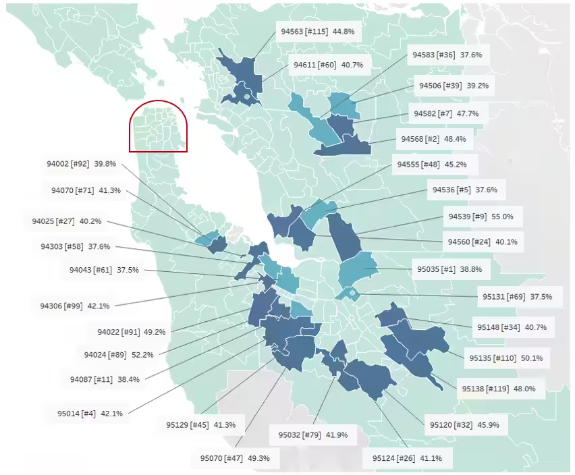
Problem Statement
Research Question
The proliferation of Electric Vehicles (EVs) presents an opportunity to reduce greenhouse gas emissions and dependence on fossil fuels. However, the lack of an optimized Electric Vehicle Charging Infrastructure distribution could hinder the adoption and efficient use of EVs. In the Bay Area, the distribution and management of EV charging stations, informed by the temporal and spatial charging behaviors, are not yet fully understood. This knowledge gap poses a challenge to urban planners, policymakers, and infrastructure providers who need to ensure the EVCI is accessible, environmentally sustainable, and meets the growing demand.
How can the human mobility patterns of charging behavior in the Bay Area be analyzed to improve the distribution and management of Electric Vehicle Charging Infrastructure for current use and future expansion?
Figure 2. San Francisco Bay Area zip codes by EV Retail Share: April 2022-March 2023
Notes:
With the understanding about our current situation, we would like to propose our problem statement and research questions.
The increasing number of EVs in bay area addresses less dependence on fossil fuels, shown on the right, the map indicates the percentage of EV ownership in Bay Area.
However, we have also realized another concerns about lack of EV Charging Stations distributed in the Bay Area.
To be more specific, the distribution and management of EV charging stations, informed by the temporal and spatial charging behaviors, are not yet fully understood.
This knowledge gap poses a challenge to urban planners, policymakers, and stakeholders who cares about EV charger availability and environmental sustainability in Bay Area.
Therefore, we ask the main question of our research: How can the human mobility patterns of charging behavior in the Bay Area be analyzed to improve the distribution and management of Electric Vehicle Charging for current use and future expansion?
https://www.spglobal.com/mobility/en/research-analysis/firstever-major-us-metro-area-hits-50-electrified-vehicle-regi.html

Slide 5
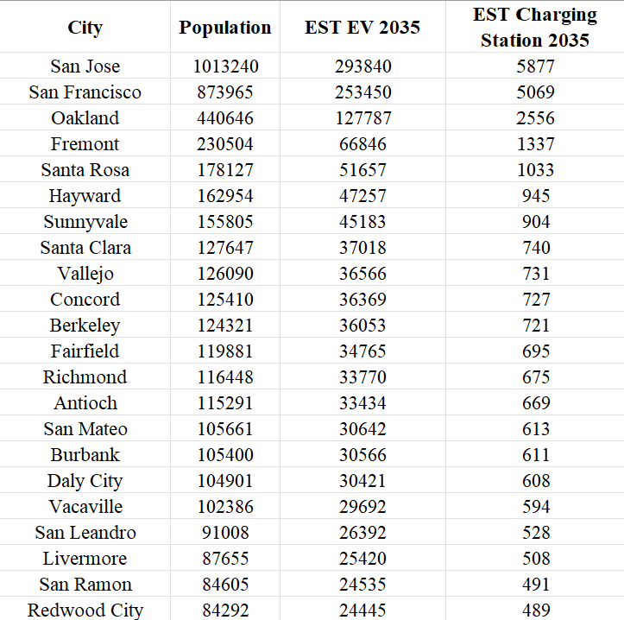
Prediction of EV and Charging Station in 2035
Presently, the Bay Area accommodates 0.33 million new energy vehicles. We predict that the new energy vehicles in Bay Area will reach to 2.21 million in 2035, reflecting a growth factor of 6.7 times. The anticipated per capita ownership of new energy vehicles in the year 2023 is prognosticate to attain 0.29 vehicles.
According to official government projections, an estimated 12.5 million new energy vehicles are anticipated to be in circulation in California by the year 2035.
Figure 2: The population and the number of 2035 new energy vehicles of some Bay Area cities
Notes:
Before we get into the application of human mobility and data sources, we have predicted the number of EVs in 2035 based on the growth factor, based on our calculations, the new EVs in Bay Area will reach 2.21 million.
According to official government projections, an estimated 12.5 million new energy vehicles are anticipated to be in circulation in California by the year 2035.
预测数量
https://calmatters.org/environment/2023/01/california-electric-cars-grid/

Slide 6
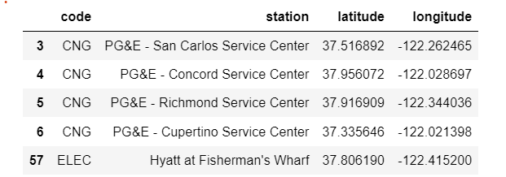
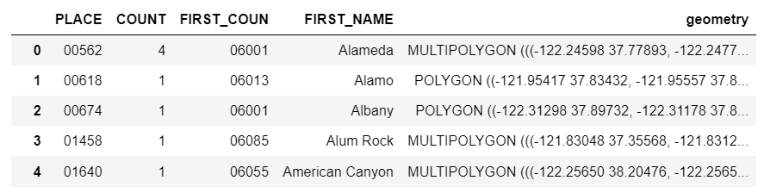
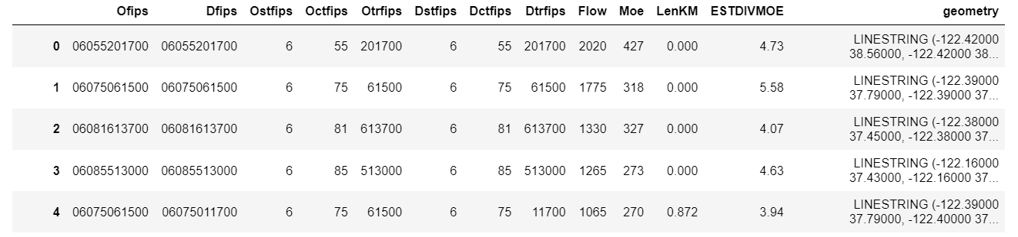
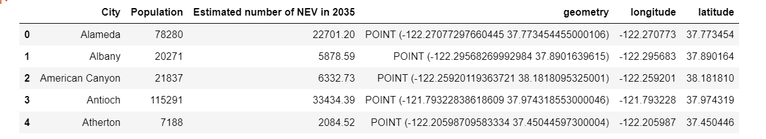
Data Source
Charging Station Dataframe
City Geometry
Dataset Source:
Charging Station Dataset:
US Department of Energy https://afdc.energy.gov/fuels/electricity_locations.html#/analyze?fuel=ELEC
Bay Area Cities Dataset:
Cartographic Boundary by US Census Bureau
https://www.census.gov/geographies/mapping-files/time-series/geo/cartographic-boundary.html
The U.S. Commute Dataset:
Rae, Alasdair; Nelson, Garrett G.D. (2016). United States Commutes and Megaregions data for GIS. The University of Sheffield. Dataset. https://doi.org/10.15131/shef.data.4110156.v5
Population Dataset:
2020 Population Census
Commuting Dataframe
Population Dataframe
Notes:
Fangjun

Slide 7
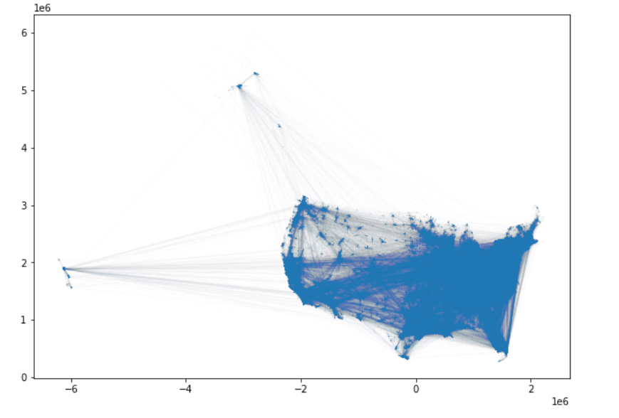
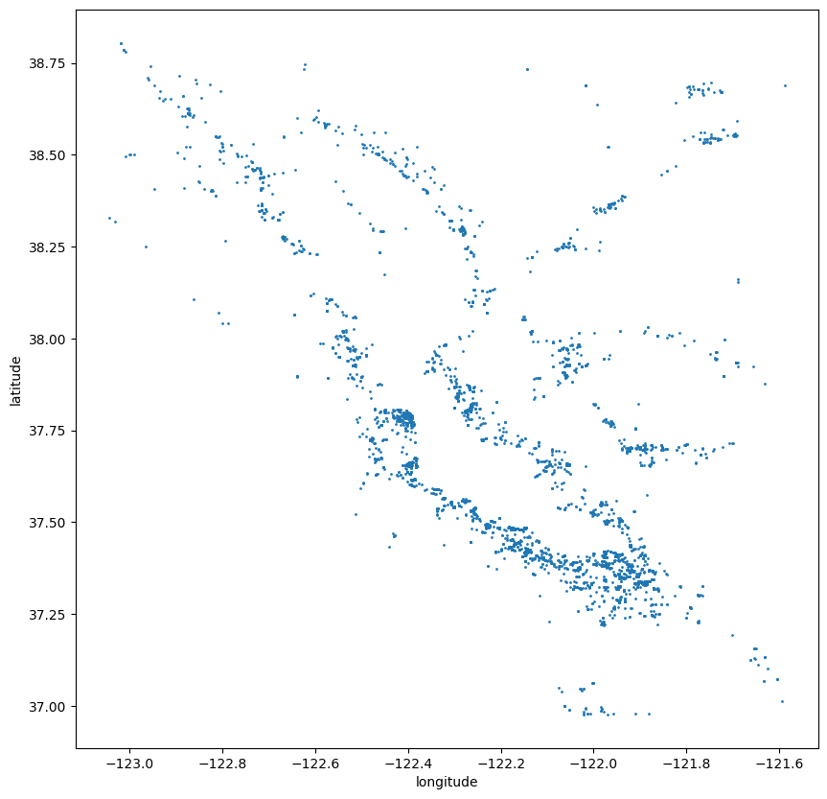
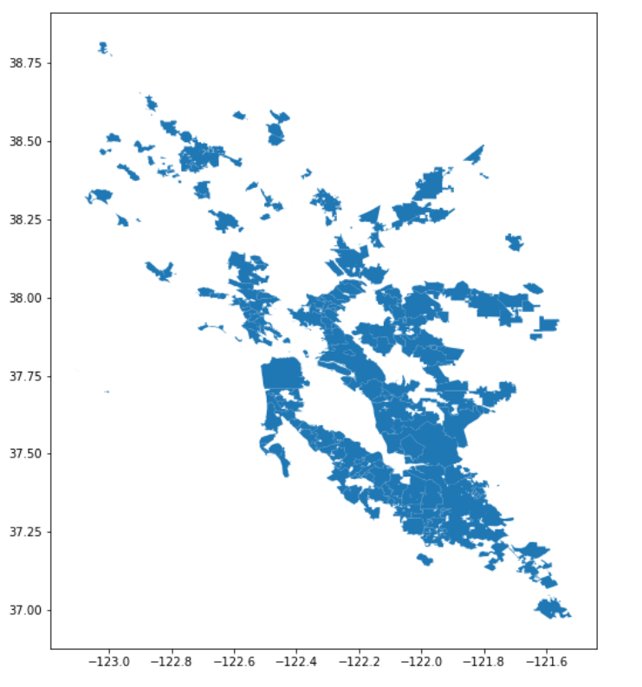
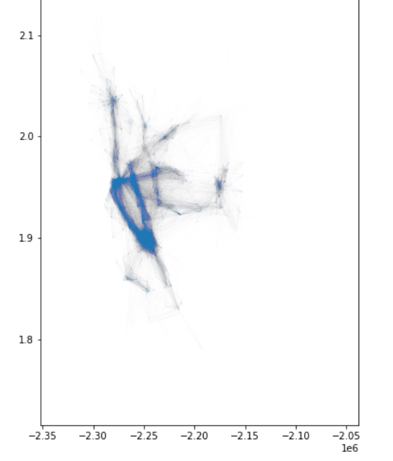
Bay Area Commuting Flows
The U.S. Commuting Flows
Plots
Charging Stations Distribution
City Blocks
Notes:
Fangjun

Slide 8
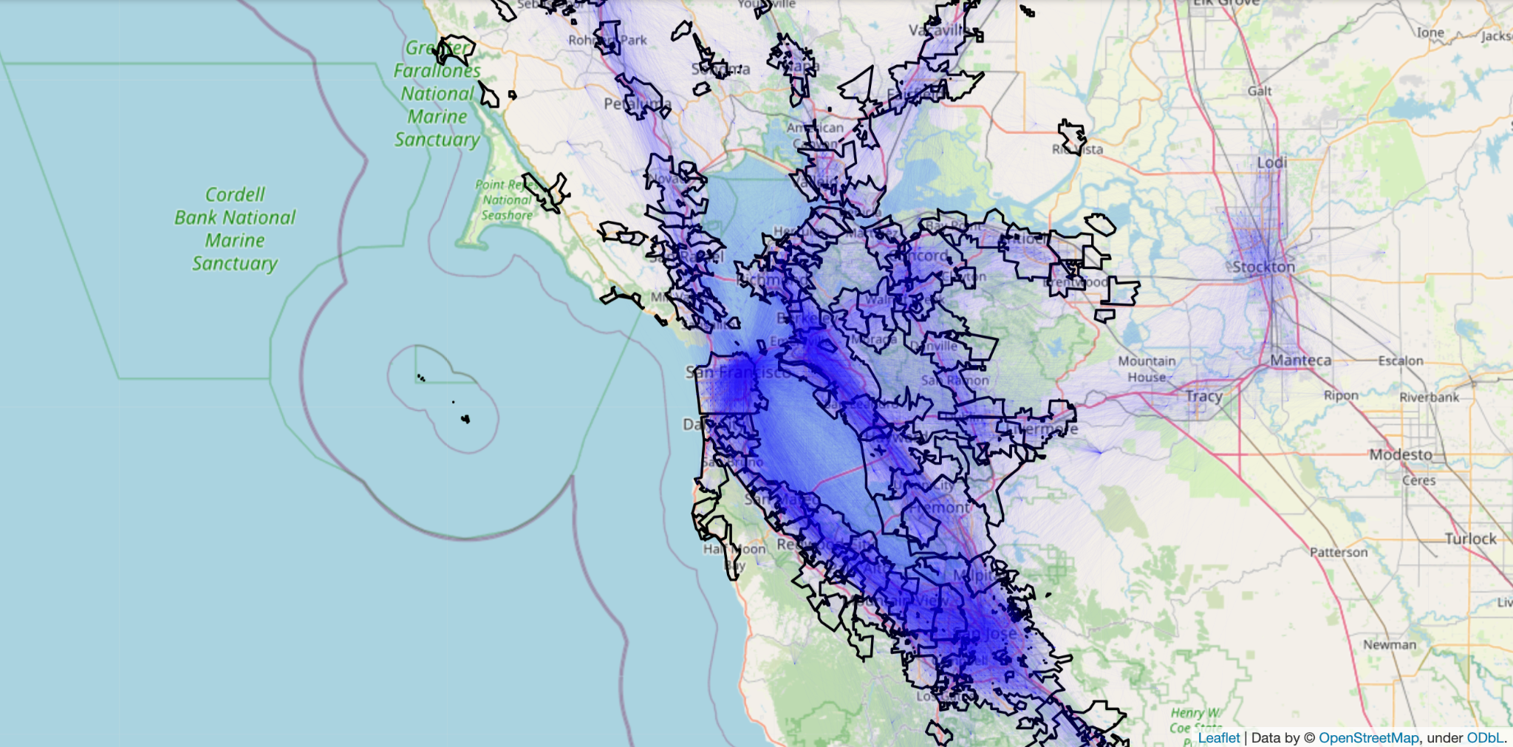
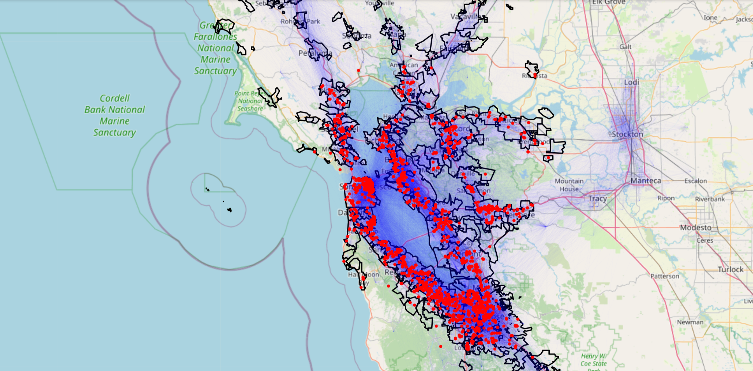
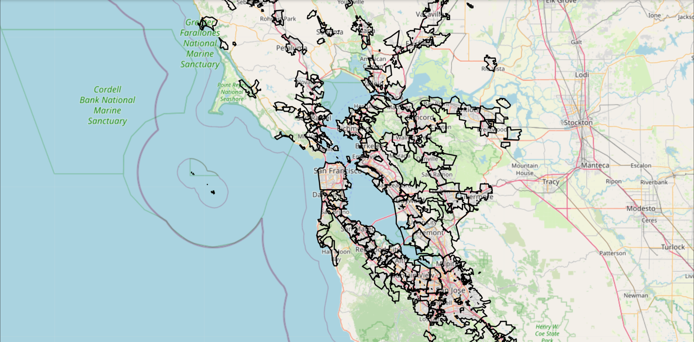
Visualization
Charging Stations Distribution
Commute Flows
City Blocks
Notes:
Fangjun

Slide 9
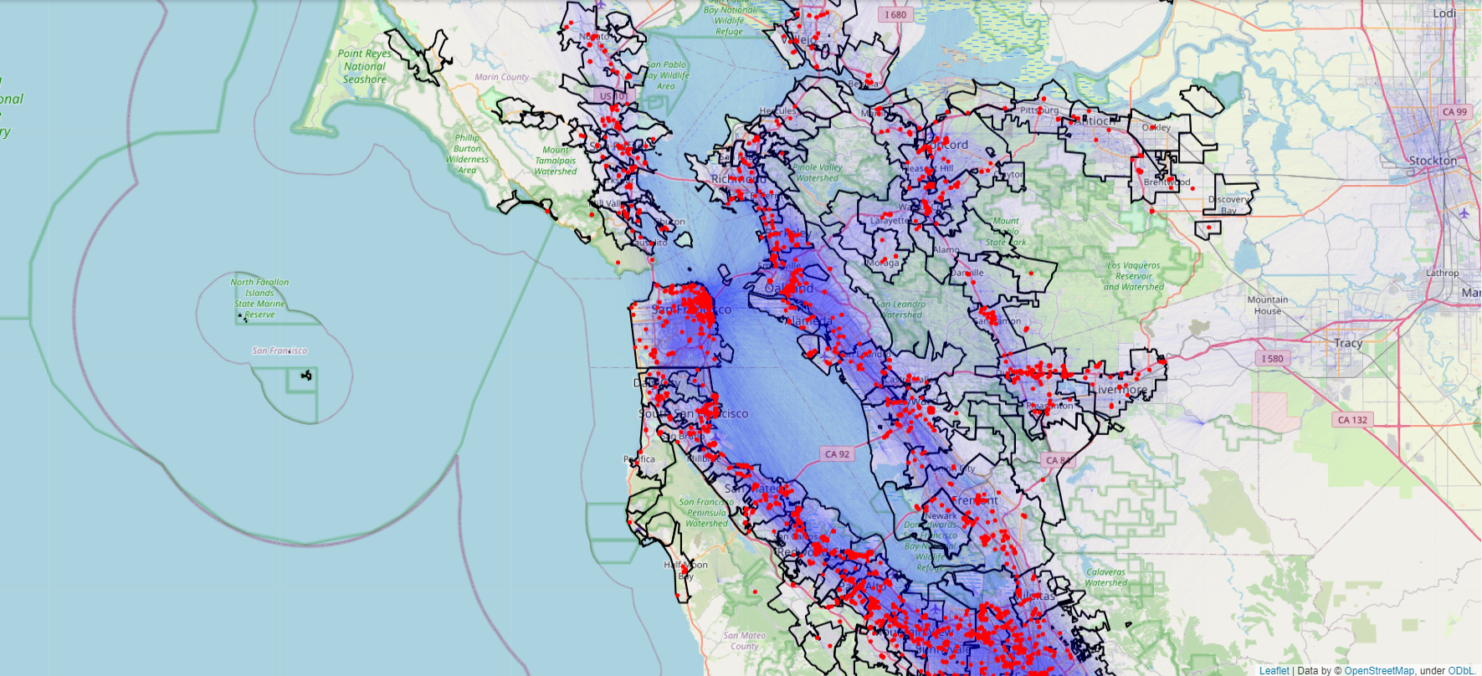
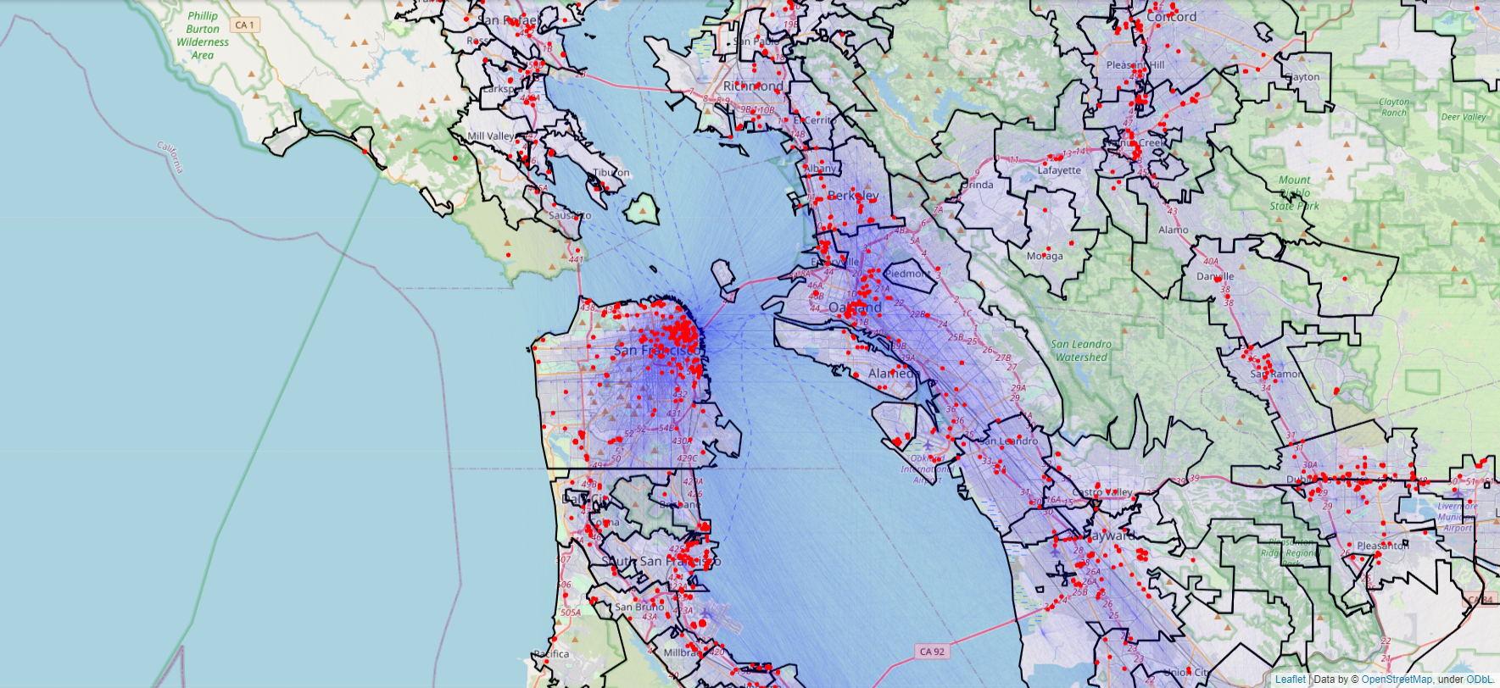
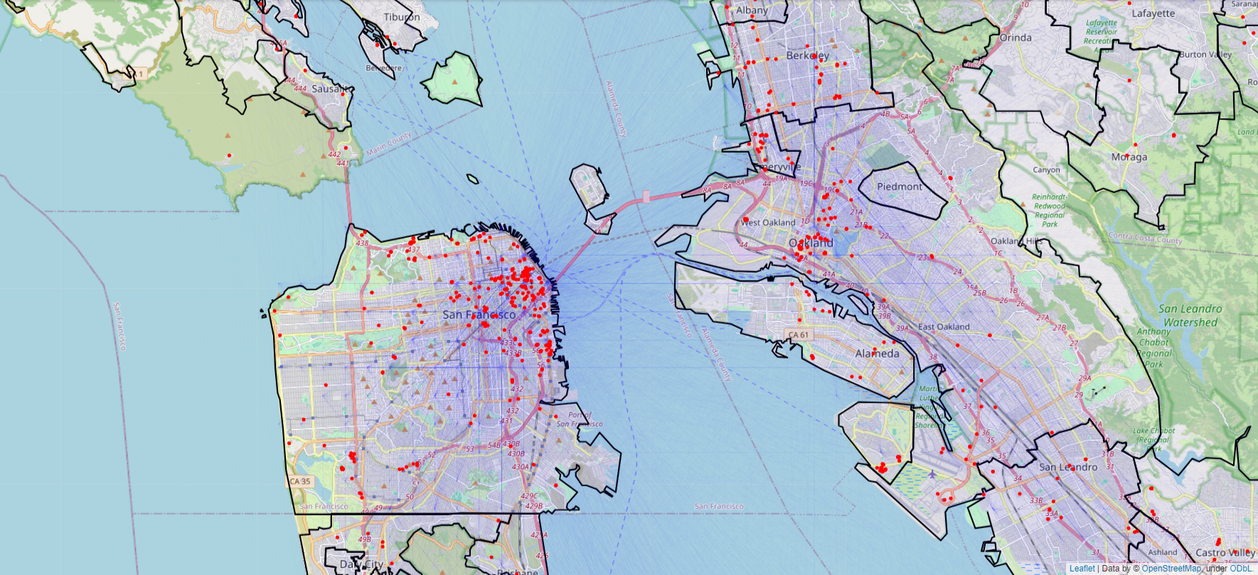
Get Closer!
Bay Area Charging Station and Population Density Contrast
Notes:
Fangjun

Slide 10
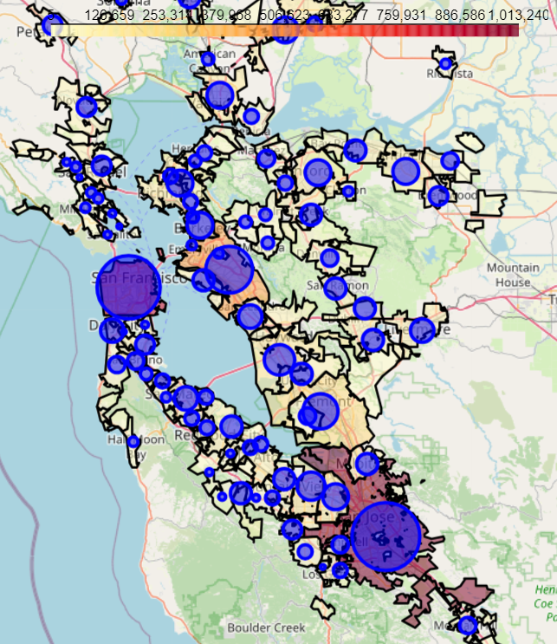
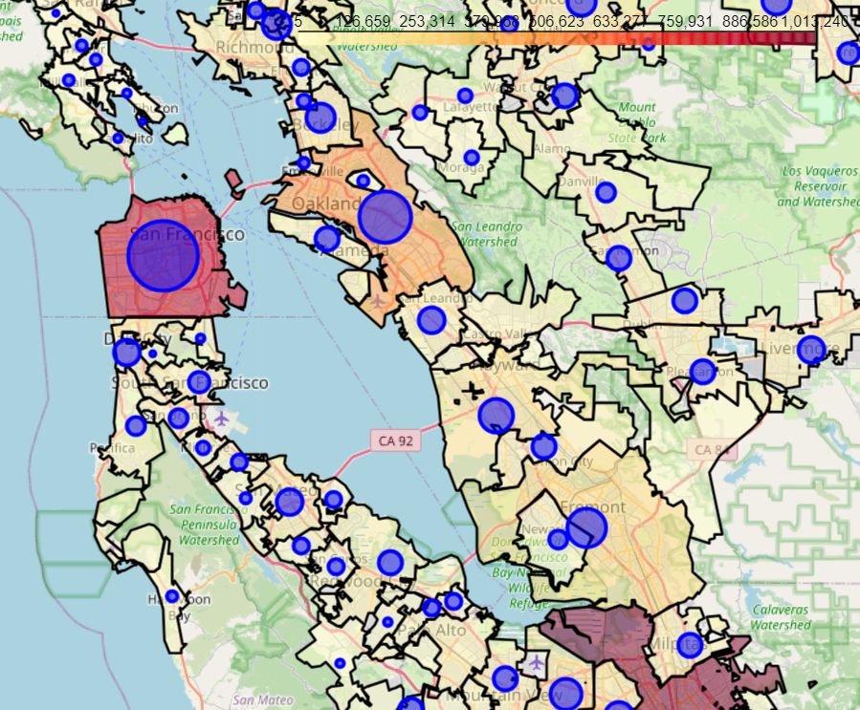
Population Density Contrast Electric Vehicles
Notes:
Fangjun
我们根据现有充电站和充电汽车的比例关系预测的2035年需要的充电桩数据

Slide 11
Network Analysis
Nodes: In the context of EV networks, our nodes represent different geographic areas within the Bay Area that have been identified by population density ranges, which is the geographic points of city.
Links: Links represent the paths connecting these nodes, representing potential travel routes for EV users.
Weighted or Not: The network was weighted by the number of charging stations in each area
Directed or Not: The network is directed since the flow of EV users would be in specific directions from their original counties and then to their destinations.
Small-World Property: Waiting to be tested if the network has many tightly knit clusters with some shortcuts connecting them, it may exhibit small-world properties, which can be advantageous for efficiency in travel and energy distribution.
Statistical Data:
Number of Users: Represent the count of EVs in each city.
Visited Locations: Represent the count of unique charging stations and geographic areas visited by EV users.
Trip Production and Attraction:
Trip Production: The number of trips originating from each node in the network, which might correlate with population density.
Trip Attraction: The number of trips attracted to each node , likely influenced by the availability and capacity of charging stations.
Population: The number of people living within each node, as indicated by the population density data.
Area of Study: The geographical boundaries of the Bay Area or the specific regions within it that you're focusing on.
Notes:
Fangjun

Slide 12
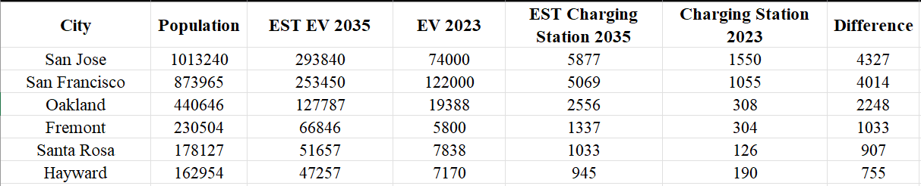
Results
We took the top 6 cities with the highest population as examples, summarized all the collected and estimated data. In the end, we found the differences between actual number of charging stations and estimated number of charging stations
Notes:
Guanhua

Slide 13
EV Charger Site Selection Suggestions
After considering the city's layout, charging stations for electric vehicles will be placed first in convenient locations like apartments, companies, shopping malls, and restaurants. At the same place, we can have charging stations with different power levels for different power conditions.
Notes:
Guanhua
Charging Stations Distribution
https://iopscience.iop.org/article/10.1088/1755-1315/781/4/042003/pdf

Slide 14
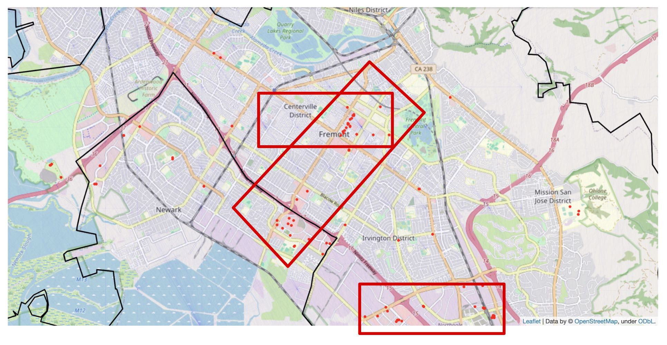
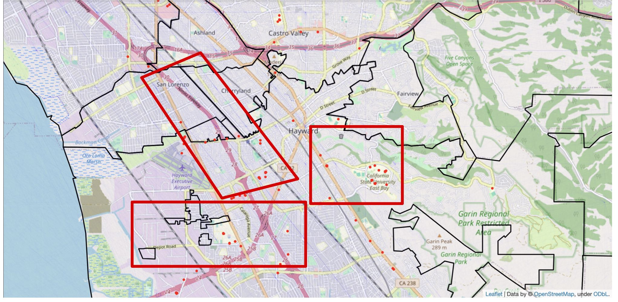
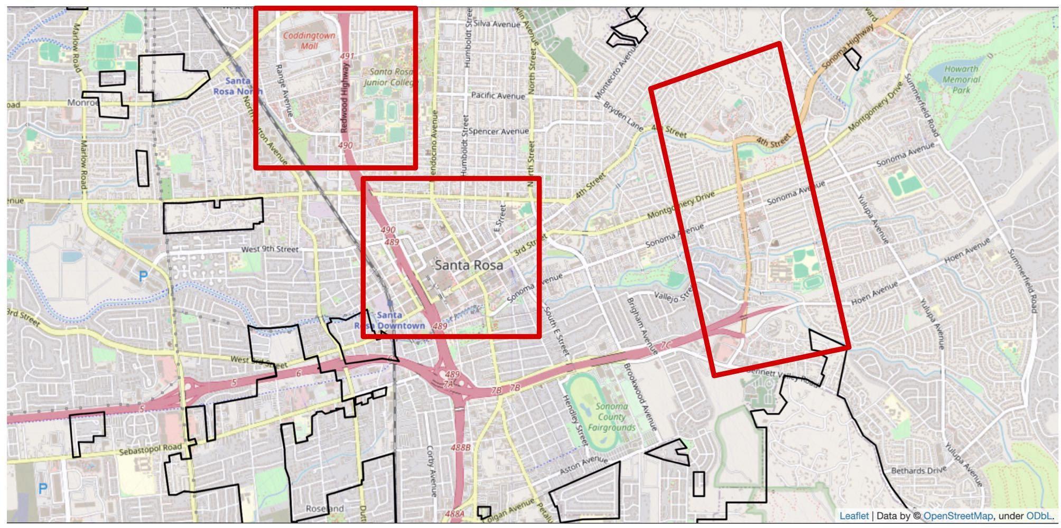
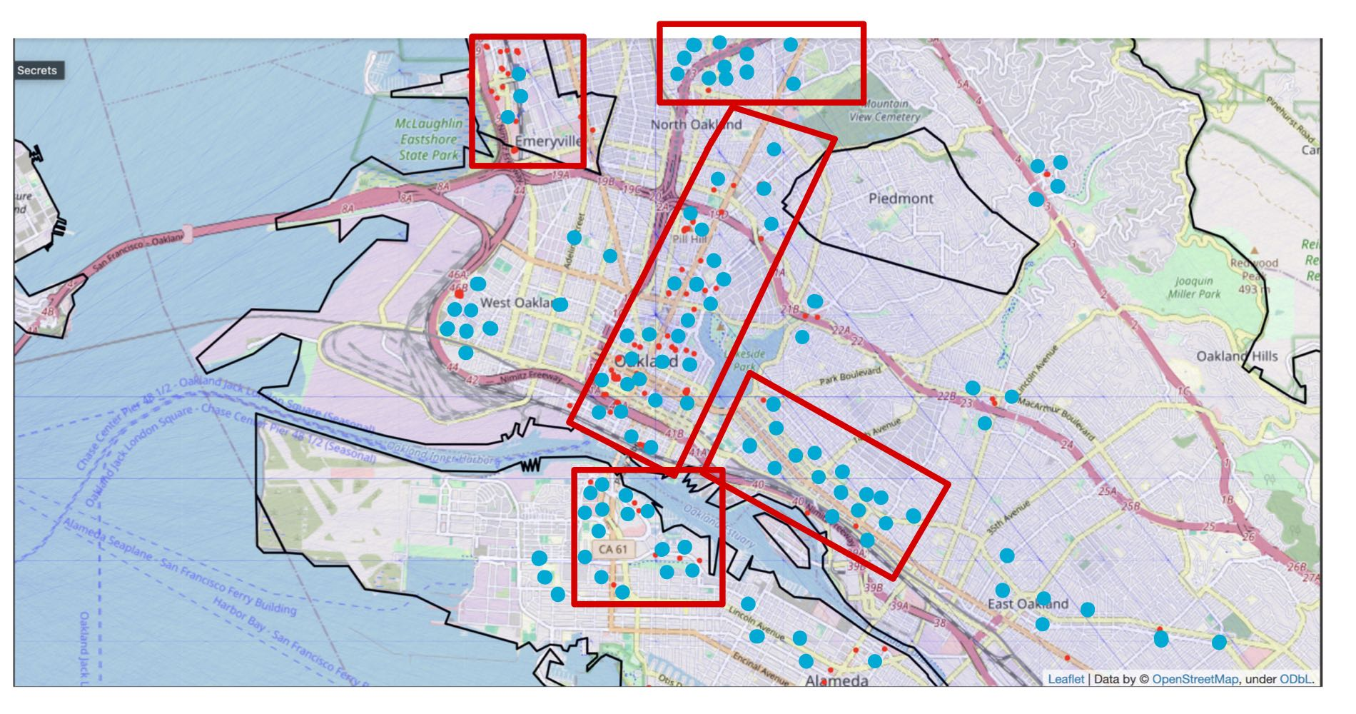
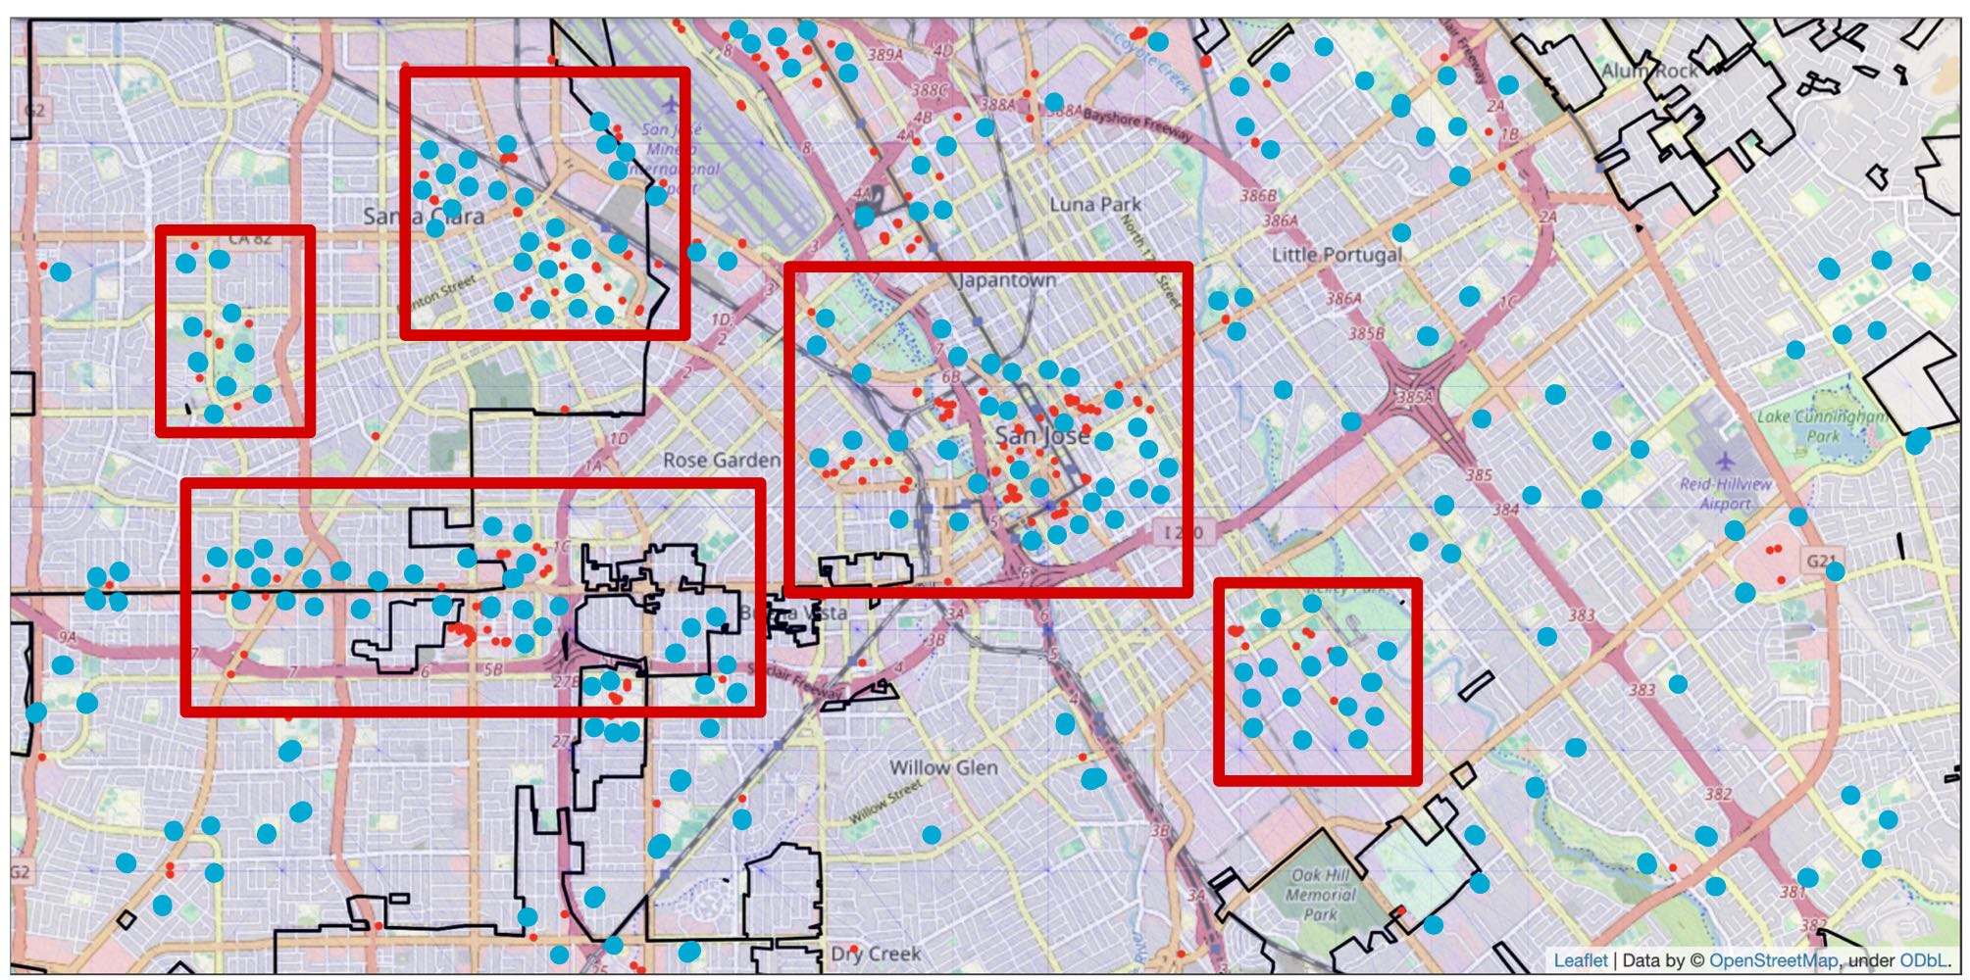
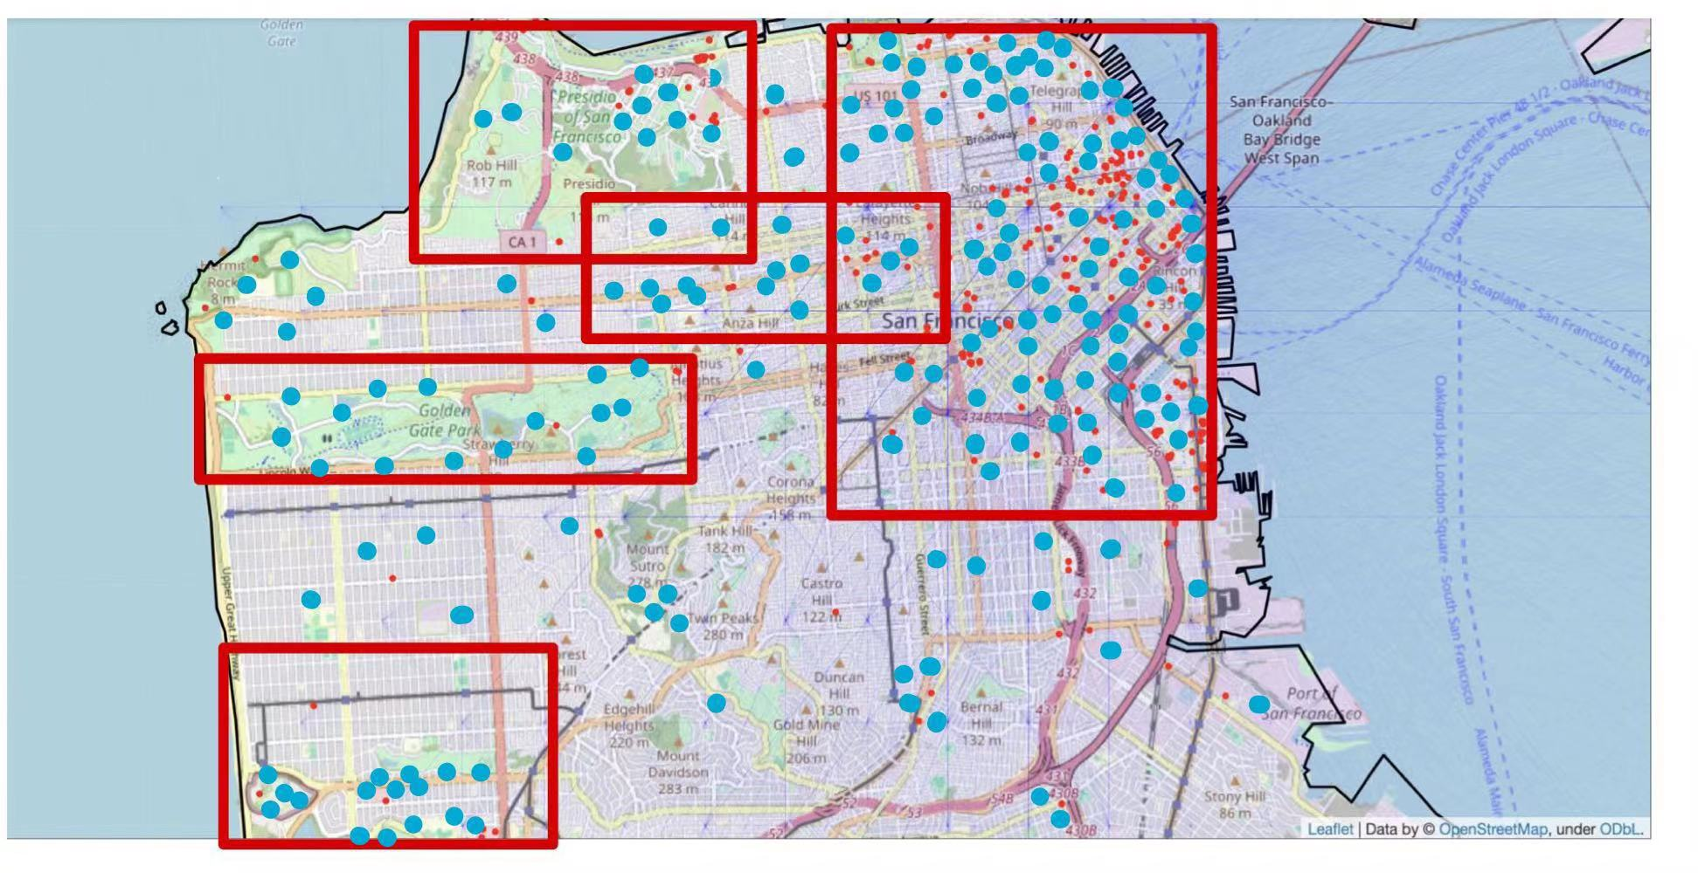
Recommandation
Company
Apartment
Shopping center
Supermarket
Hotel
Restaurant
Park
Notes:
Guanhua

Slide 15
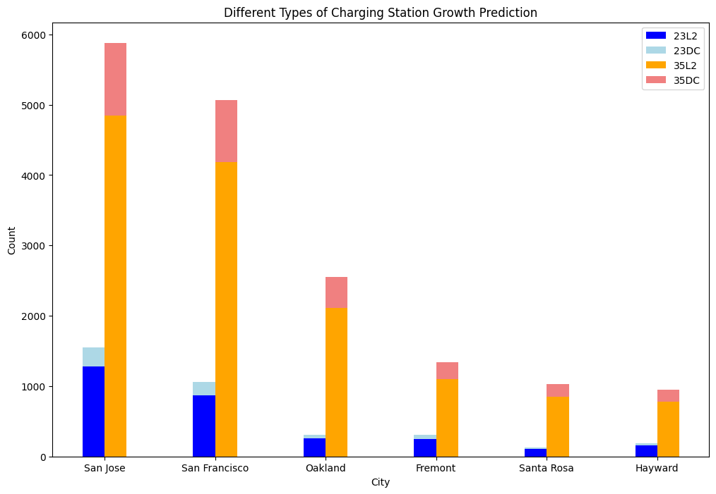
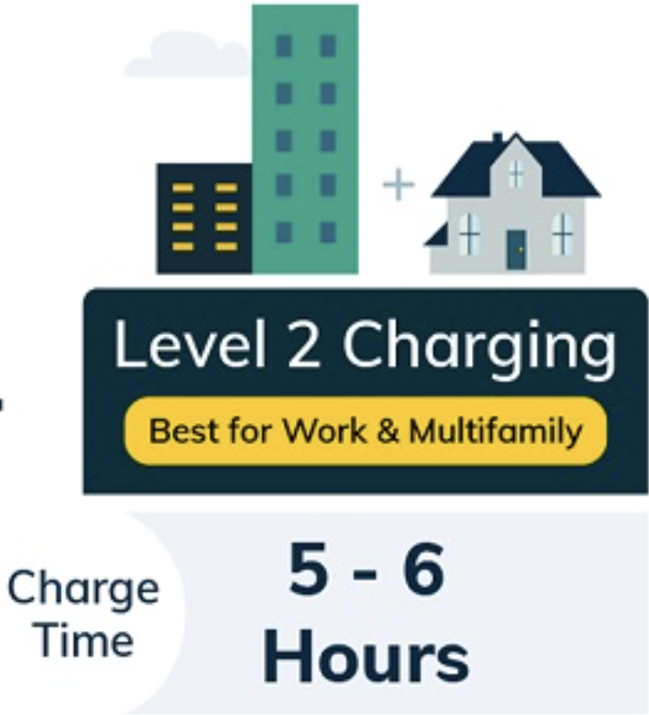
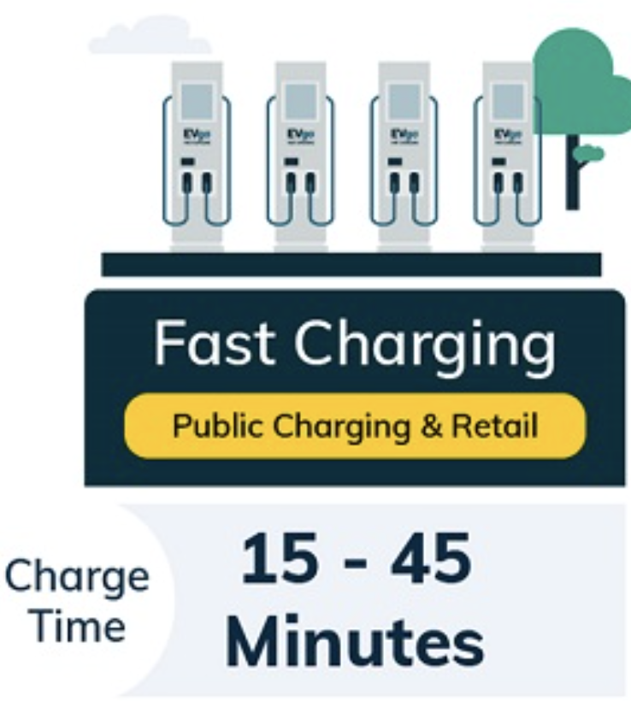
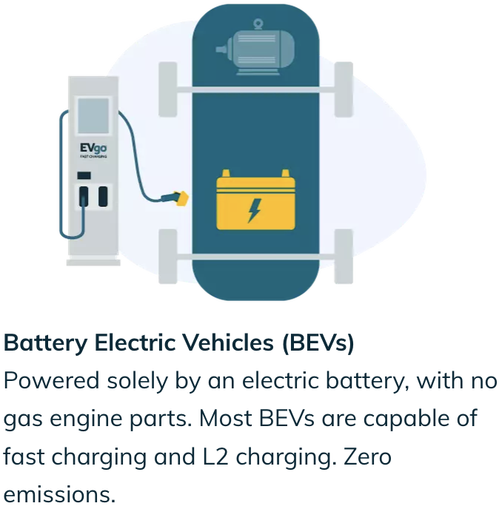
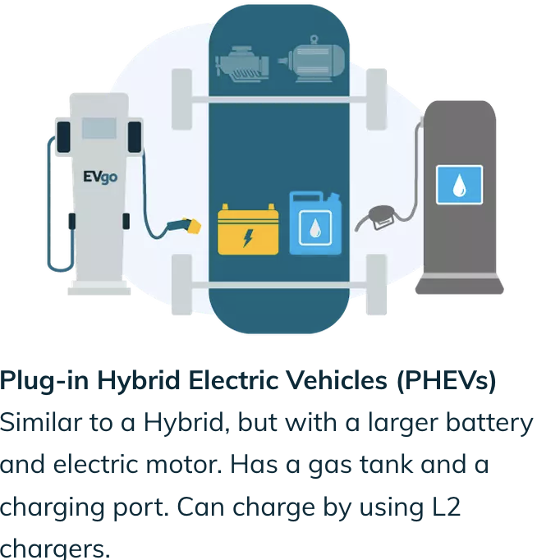
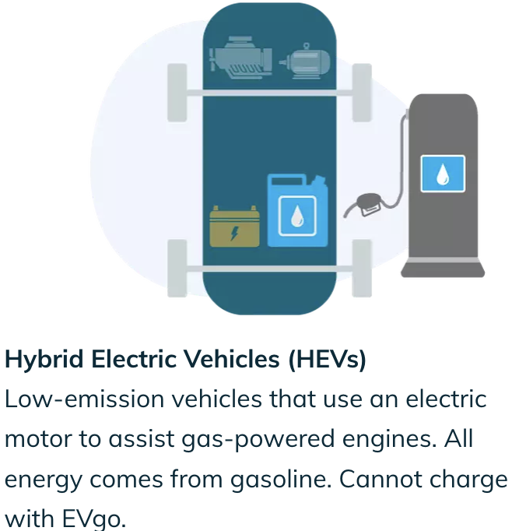
Types of Electric Vehicles and Charging Stations
Notes:
3 types of EV
2 types of Charging stations:
DC Chargers are designed for the electric cars road trips

Slide 16
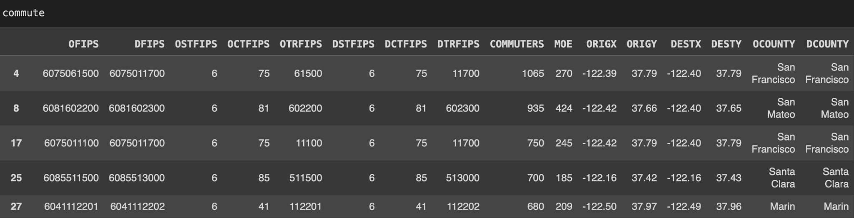
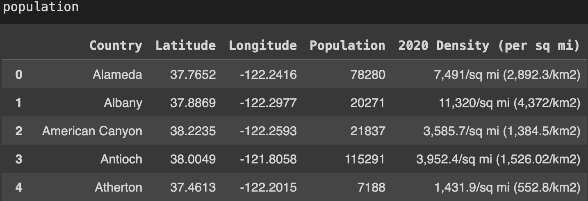
Limitations
Dataset Limitation:
Commute Dataset:
Location: All locations are encoded by FIPS code
Useless data: Most codes are untrackable, and some information is unhelpful
Population Dataset:
Center Coordinates: The dataset does not have a polygon coordinates for each cities.
Information Limitation:
Lack of the datasets that contain different types of electric vehicles and different types of chargers
Lack of specific city data (buildings, streets, and parking lots)
Lack of regional wealth data
Lack of the usage of each charging station
Lack of the distribution of private charging stations (L1 Chargers)
Notes:
Commute:
there are no timestamps, inflows, outflows
All locations are encoded
Don’t know the meaning of 6 digits number → use coordinates to figure out the starting and ending position of each flow

Slide 17
Future work
Expand the datasets to include various types of electric vehicles and their specific charging requirements could provide deeper insights. Collect data on the actual usage of each charging station would help in understanding temporal patterns and peak demand times.
Expand the dataset by integrating additional relevant features such as specific city data (buildings, streets, parking lots) which may influence the distribution of fraudulent job postings.
Investigate the distribution of private charging stations and include this information to provide a more comprehensive overview of the job market landscape.
Incorporating regional wealth data could offer a socioeconomic perspective on the accessibility and usage of electric vehicles and charging stations. This data could help in planning infrastructure that caters to diverse economic backgrounds.
Investigating the impact of existing and proposed policies on the adoption of electric vehicles and the expansion of charging infrastructure would provide critical feedback for policymakers and stakeholders.
Notes:
Qinhan

